Slide 1
SDK – Docker Image

Slide 2
SDK image basics
Goal
provide a generic development environment for all teams
customizable for different use cases
Docker base image -> sdk-infrastructure
Customizable with Ansible -> sdk-dev-env-ansible

Slide 3



Customizing base image
Docker customized image
Git configuration
Eclipse
Ansible setup
clang-format/cpplint/gtest
sdk-dev-env-ansible
Docker base image
Tools (gcc, conan, …)
git configuration
Ansible setup
sdk-dev-env-ansible
Vector SIP (D12 / D02 / ...)
Eclipse
ACC application
Vector SIP D02
… custom applications…
Playbooks

Slide 4
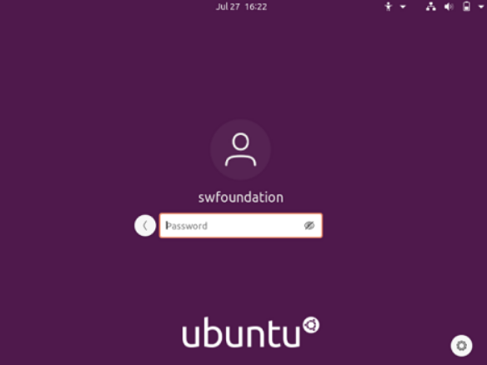
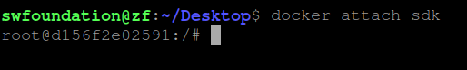
Let’s start! What do I need?
Docker Installation -> use e.g. Ubuntu 20.04 (Wiki-Page: preconfigured Ubuntu 20.4)
Docker Login -> Credentials will be provided by SDK / CICD Team
Pull, start and attach to the container…
Wiki-Page: sdk-dev-env-image-usage
>> docker login azp006acr.azurecr.io
>> docker pull azp006acr.azurecr.io/swf/sdk-dev-env:latest
>> docker run -d -it -e DISPLAY=$DISPLAY -v /tmp/.X11-unix:/tmp/.X11-unix --name <container_name> azp006acr.azurecr.io/swf/sdk-dev-env:latest /bin/bash
>> xhost +
>> docker start <container_name>
>> docker attach <container_name>

Slide 5
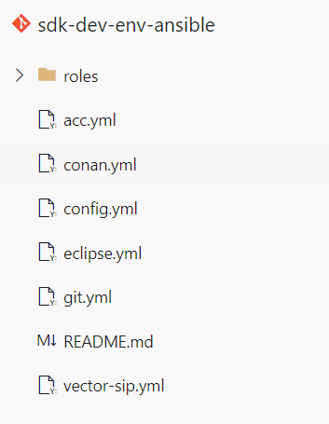
“Hands on” applying ansible playbooks
Currently available playbooks (sdk-dev-env-ansible)
acc.yml
conan.yml
eclipse.yml
git.yml
vector-sip.yml
-> Contribution to the repo is welcome
Fill out config.yml
Run playbook
Wiki-Page: Usage-of-ansible-playbooks-repository
>> ansible-playbook <playbook_name> -vvv -e @config.yml

Slide 6
Feedback & Questions
Start using the SDK image
Feedback is highly appreciated
Please let us know what you need ☺!
Participate in the playbook-creation (sdk-dev-env-ansible)
Wiki overview
Ubuntu 20.04 virtual image: preconfigured Ubuntu 20.4
Usage of SDK Image: sdk-dev-env-image-usage
Questions?

